Slide 1
Good morning ☺
We will start the lab at 10:15am

Slide 2
MA-INF 4314 - Lab Semantic Data Web Technologies
Dr. Tobias Grubenmann, Firas Kassawat
30.10.2020

Slide 3
Short Introduction
My name is Tobias Grubenmann, feel free to call me “Tobi”
I’m form Liechtenstein.
I did my PhD at the University of Zurich, Switzerland
I did a Postdoc at the University of Hong Kong, China
I joined the University of Bonn in April 2020.
You can reach me at: grubenmann@cs.uni-bonn.de

Slide 4
General Information

Slide 5
Overview
In this lab, you will work on a project related to Semantic Web technologies.
Up to 4 students for each project.
The project assignment procedure will be explained later.
The lab has only limited capacity.
Important information is provided on the lab webpage: https://github.com/s6fikass/semanticweblab2020-2021

Slide 6
Bi-Weekly Lab meetings
The lab is scheduled to take place on a bi-weekly basis on Friday, 10:15am to 12:00pm.
We will not make use of every single scheduled slot.
We will inform you in a timely manner when a meeting will be suspended.
You are expected to keep the bi-weekly slots open for the lab meetings.

Slide 7
Requirements to Complete the Lab
Short presentations (5 min) bi-weekly about your progress.
Final presentation at the end of the lab (20 min).
Deliverables at the end of the lab:
Code
Documentation
The final deliverables will be peer-evaluated. Further details will be provided at a later stage.
No final report is required.

Slide 8
No Free-Rider Policy
Every group member in each project is expected to do an equal amount of work.
All group members are required to actively participate in the presentations.
If any group member is clearly contributing less than their peers, she or he might get a lower grade than the others.

Slide 9
Important Notes about Registration
We will present projects and you will have the opportunity to declare your interest in the project by putting your name in a spreadsheet. (This will be explained shortly.)
The projects will be assigned to students until latest November 6, 2020.
You will be informed if you got selected for the project and will be asked to confirm that you are still available for the project.
After you have been assigned to a project, you need to register yourself in BASIS for the project.
The registration in BASIS must be completed until November 15.

Slide 10
Project assignments
We will now start with the topic presentations.
If you are interested in a project, you can put your full name and email address into the spreadsheet linked in the next slide.
You can register for multiple projects.
You can put your name with up to 3 other people together in one row, if you already know with whom you want to work together.
The project leaders will contact you within the next 7 days.
If you get chosen for a project and confirmed your participation, please cross out your name in the spreadsheet.

Slide 11
Spreadsheet for Project Assignment
Please use the following spreadsheet to declare your interest in a project.
Please check now that you are able to access the spreadsheet.
The spreadsheet will be available until November 1, 11:59pm.
You won’t be able to enter your name after the deadline.
Link: https://uni-bonn.sciebo.de/s/IwA1dRbIxhqWezK
Password: <The password is provided in the lecture>

Slide 12
Project Presentations

Slide 13
Type of Projects
Implementation of an already published paper
In this type of labs students should implement an algorithm presented in a paper and present the results.
The results would be evaluated on one or multiple datasets.
Most likely if lab results were convincing then a master thesis topic is presented as a continuous of the lab project (if wanted)
Implementation of a code:
An API or a development layer which might be included in other projects
Which gives you the idea how to integrated software are implemented

Slide 14
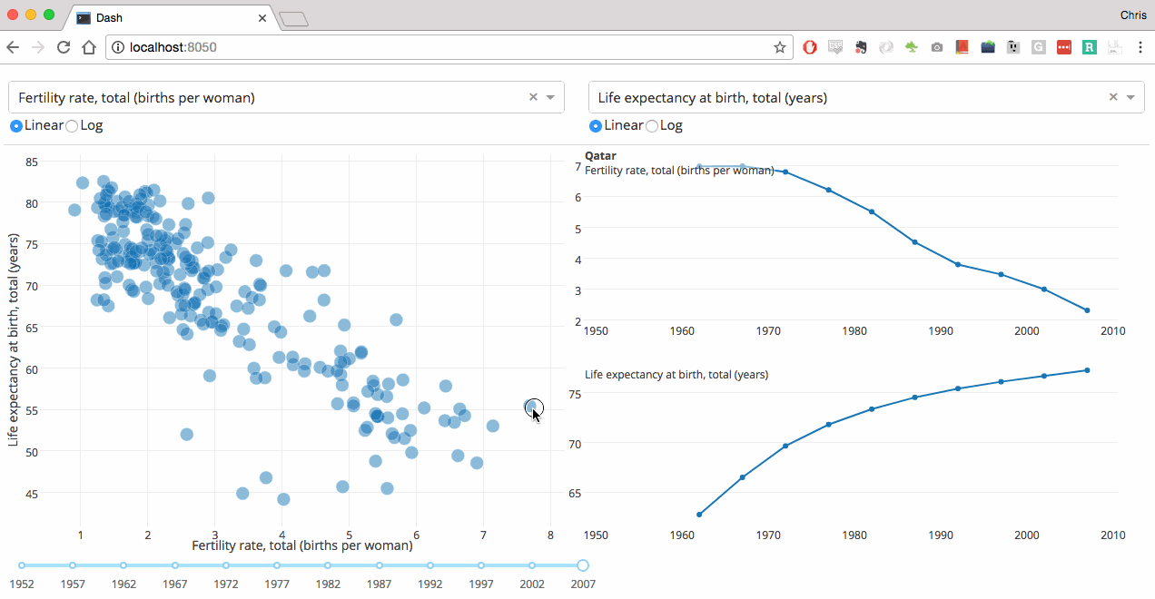
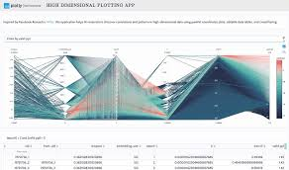
Interactive Data Analytics Dashboard for RDF Knowledge Graphs

Slide 15
Title | Interactive Data Analytics Dashboard for RDF Knowledge Graphs
Description | The objective of this lab is to develop an interactive dashboard to analyze ind visualize RDF Datasets. the tool should be standalone (not e.g. Jupyter notebook). the tool should provide easy accessible analytics and opportunities to adjust the interface to needed requirements. Mandatory elements are: selection of data source, specifying SPARQL queries, representing results of SPARQL queries as graph, table and plots (pie charts, bar charts, map) Possible Frameworks/Libraries: (pip, pandas, rdflib, jupyter, dash, ipywidgets, pipenv, github, plotly, markdown) Project Management: GitHub Kanban Boards for agile task management, gitflow for clear branch handling, Github for Version Control and hosting Readmes
Prerequisite | Knowledge in Software engineering, basic Knowledge of Data Science, python, Semantic RDF Data, GitHub, Self Motivation
Deliverable | Github repository, python code with docstrings, readme.md for setup and presentation of examples, evaluate performance, interactive layoutable dashboard
Training | List of readings, example Code fragments, tutorial for setup
Documentation | Code documented by docstrings, Setup and Examples of program over GitHub hosted readme.md for setup and presentation of examples
Bonus Work | dockerized standalone application, host docs on Github pages, selenium tests for dashboard testing

Slide 16
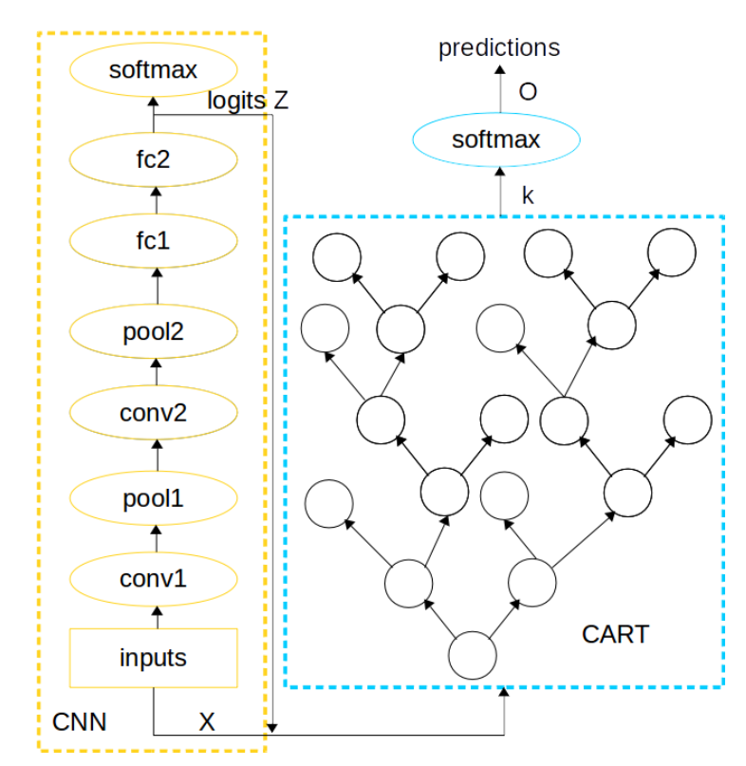
Distillation of DNN Networks into Gradient Boost tree model
The Objective of this lab is to implement an algorithm that takes the result of a neural network and train a decision Tree based on it.
The algorithm needs to be implemented is referenced here:
Zhengping Che, Sanjay Purushotham, Robinder Khemani, and Yan Liu. Interpretable deep models for icu out comeprediction.AMIA Annual Symposium Proceedings, 2016:371–380, 02 2017
Type of decision Trees : Gradient Boosting Trees
No need to start from scratch you can use an already implemented base and work on it but documentation should be provided for all and references to code should be there.
Do not use other peoples works as your own

Slide 17
Title | Distillation of DNN Networks into Gradient Boost tree model
Description | The objective of this lab is to implement a Gradient Boost tree model by taking an already trained neural network and use the trained logits alongside the original data to train the tree model. As a variation you also need to pre-process the logits from the DNN by training a logistic regression algorithm that outputs the required soft predictions and use them to train the model. (details are provided int eh given references) You can use an already implemented algorithm and tweak it to get the results
Prerequisite | Basic machine learning knowledge, python, Implementation of decision Trees,
Deliverable | Code. Validation results. Documentation of how to run the code how to evaluate and produce the results. Final presentation about the algorithm and the validation done.
Training | Two weeks training on DNN and Pytorch. Benchmark implementation of the algorithms.
Documentation | Required ( How to run )
Bonus work | Using other type of decision Tress. Tuning to generate the same results as the paper.

Slide 18
Example Based explanations of a trained ML-model for RDF and Tabular data
The objective of this lab is to implement algorithms such as ( K-Nearest Neighbor and other to be mentioned later ) given a predicted sample (X,Y) (input , output label) of data and a group of training samples I and a number K and then the implemented algorithm should identify and output the K nearest samples from I that resembles (X,Y).
The implement algorithm should work on Tabular and RDF data.
Refrence:
Efficient Data Representation by Selecting Prototypes with Importance Weights, 2019 , Gurumoorthy et. al
Interpretable Counterfactual Explanations Guided by Prototypes, 2019 - Van Looveren, Klaise
Examples are not Enough, Learn to Criticize Criticism for Interpretability, 2016, Kim ,Khanna, Koyej

Slide 19
Title | Example Based explanations of a trained ML-model for RDF and Tabular data
Description | The objective of this lab is to implement algorithms such as ( K-Nearest Neighbor and other to be mentioned later ) given a predicted sample (X,Y) (input , output label) of data and a group of training samples I and a number K and then the implemented algorithm should identify and output the K nearest samples from I that resembles (X,Y). The implement algorithm should work on Tabular and RDF data.
Prerequisite | Semantic RDF data, basic knowledge in machine learning similarities algorithm, python, Knowledge in software engineering
Deliverable | Project Code to be used as an API ( to be called from different projects) Documentation of the functionalities implemented and if there a specific installation required. Final presentation describing the overall work with a demo.
Training | Two weeks training on querying RDF and tabular data and detecting what kind of similarities they have. Benchmark implementation of the algorithms.
Documentation | Required with no restrictions or preferences
Bonus work | Allowing the algorithm to accept image data. Using the ML model that produced (X,Y) to evaluate the K results.

Slide 20
SANSA RDF and ML python interface
SANSA is a big data engine for scalable processing of large-scale RDF data.
SANSA uses Spark and Flink which offer fault-tolerant, highly available and scalable approaches toefficiently process massive sized datasets.
SANSA provides the facilities for Semantic data representation, Querying, Inference, and Analytics.

Slide 21
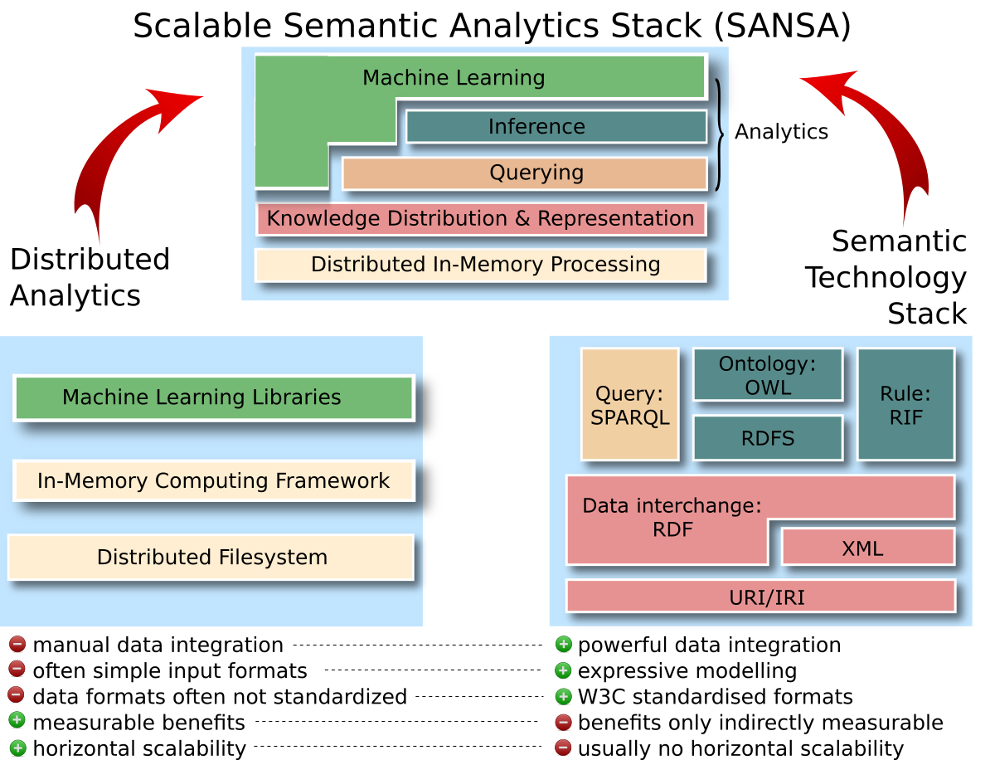

Slide 22
Title | SANSA RDF and ML python interface
Description | The objective of this lab is to implement a python wrapper that wraps and calls the Scala code. Wrapper should be implemented in an object oriented structure and should implemetns the machine learning and queering functionalities of SANSA.
Prerequisite | Semantic RDF data, basic knowledge in machine learning similarities algorithm, python, Knowledge in software engineering
Deliverable | Project Code to be used as an API ( to be called from different projects) Documentation of the functionalities implemented. Final presentation describing the overall work with a demo. Jupiter python notebooks showing the samples of the running code
Training | Two weeks training on SANSA installation and use.
Documentation | Required with no restrictions or preferences
Bonus work | Using SANSA-Stack full functionality. Implementing a bridge of functionality between SANSA and the python Wrapper

Slide 23
Implement and design a machine learning hierarchy wrappers for SimpleML
Objective: Design and Implement a hierarchy of machine learning functionalities
Design an ontology and a hierarchy for the adapters and functionalities provided by ( Scikit, pytorch, Tenserflow ) use the Mex Ontology as a basis.
Implement some of the functionalities mentioned in the design.

Slide 24
Title | Implement and design a machine learning hierarchy wrappers for SimpleML
Description | The objective of this lab is to design a small ontology for machine learning processes available in Scikit, and implement algorithms
Prerequisite | Semantic RDF data, basic knowledge in machine learning, python, Knowledge in software engineering
Deliverable | Project Code to be used as an API ( to be called from different projects) Documentation of the functionalities implemented and if there a specific installation required. Final presentation describing the overall work.
Training | Two weeks training on pytorch and scikit and rdf and ontology creation.
Documentation | Required with no restrictions or preferences
Bonus work | Merging the created ontology with the MEX ontology. Using the ontology to make fault detection.

Slide 25
Title | Machine learning for Entity Matching
Description | The objective of this lab is to implement an algorithm for an entity matching. Entity Matching (EM) is the problem of determining if two entities in a data set refer to the same real-world object. Entity matching is a ubiquitous problem that appears in numerous application domains (including image processing, information extraction and integration, and natural language processing), often under different terminology (e.g., coreference resolution, record linkage, and deduplication). Machine learning approaches for entity matching often learn a classifier over pairs of entities labeling them as duplicate or non-duplicate. Here we focus on implementation of a one specific algorithm using Python and PyTorch on the Knowledge Graphs. The implemented algorithm should work on RDF data.
Prerequisite | Semantic RDF data, basic knowledge in machine learning, Python, Knowledge in software engineering
Deliverable | Project Code to be used as an API (to be called from different projects) Documentation of the functionalities implemented and if there a specific installation required. Final presentation describing the overall work with a demo.
Training | Two weeks training on PyTorch
Documentation | Required with no restrictions or preferences
Bonus work | Testing the algorithm on 3 different benchmark types.

Slide 26
Outlook: Next meeting

Slide 27
Preparation for next meeting
The next meeting will take place in two weeks, on November 13, 2020.
Please prepare a 5 min presentation where you will:
Very shortly present the topic of the project.
Introduce yourself.
Explain what is your background and why you want to work on this project.

